Slide 1
HISTORY OF MICROPROCESSORS
T V MURALI KRISHNA

Slide 2
Definitions
Microprocessor:
The central processing unit built on a single IC is called Microprocessor.
A microprocessor (sometimes abbreviated as µP) is a digital electronic component with miniaturized transistors on a single semiconductor integrated circuit (IC).

Slide 3
Microprocessor Characteristics
Instruction Set:
The set of instructions that a microprocessor can understand.
Clock Speed:
The clock speed determines how many operations per second the processor can perform.
It is also called Clock Rate.
Every computer contains an internal clock that regulates the rate at which instructions are executed and synchronizes the various computer components.
The faster the clock, the more instructions the CPU can execute per second.
Clock speeds are expressed in megahertz (MHz) or gigahertz (GHz).
The microprocessors of personal computers have clock speeds of anywhere from 300 MHz to over 3.8 GHz.

Slide 4
Microprocessor Characteristics
Word Length:
Length of bits that microprocessor can process at a time
It depends upon the width of internal data bus, registers, ALU etc.
An 8-bit microprocessor can process 8 bit data at a time.
A processor with longer word length is more powerful and can process data at a faster speed as compared to processor with shorter word length.
The word length ranges from 4 bits for small microprocessor, to 64 bits for high-end microcomputers.

Slide 5
Microprocessor Characteristics
Width of Data Bus:
This is the size of the data bus. It defines the number of bits that can be transferred through data bus.
Width of Address Bus:
This parameter decides the memory addressing capability of the microprocessor. The maximum size of the memory unit is decided by this parameter.

Slide 6
Features of Microprocessor
Cost:
The most important feature of a microcomputer is its low cost.
Because of the widespread use of microprocessors, the volume of production is very high.
That is why, microprocessor chips are available at fairly low prices.
Size:
The second important feature of a microprocessor is its small size.
As a result of improvement in fabrication technology, VLSI, electronic circuitry has become so dense that a minute silicon chip can contain hundred and thousands of transistors.

Slide 7
Features of Microprocessor
Power Consumption:
Another important feature is its low power consumption.
Microprocessors are normally manufactured by Metal-Oxide semiconductor technology, which has the feature of low power consumption.
Versatility:
The microprocessors are versatile.
Keeping the same basic hardware, a microprocessor-based system can be configured for a number of applications by simply altering the software program.
Reliability:
Another important property of microprocessors is its extreme reliability.
It has been established that the failure rate of an IC is fairly uniform at the package level, regardless of its complexity.

Slide 8
Different micro processors
4-Bit Microprocessors
8-Bit Microprocessors
16-Bit Microprocessors
32-Bit Microprocessors
64-Bit Microprocessors

Slide 9
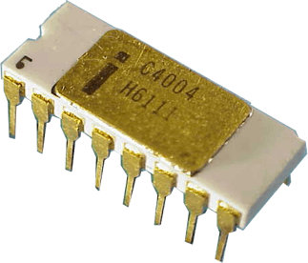
Intel 4004
Introduced in 1971.
It was the first microprocessor by Intel.
It is a 4-bit µP.
Its clock speed was 740KHz.
It had 2,300 transistors.
It could execute around 60,000 instructions per second.

Slide 10
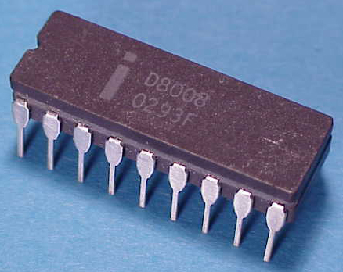
Intel 8008
Introduced in 1972.
It was first 8-bit µP.
Its clock speed was 500 KHz.
Could execute 50,000 instructions per second.

Slide 11
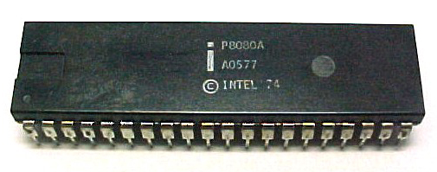
Intel 8080
Introduced in 1974.
It was also 8-bit µP.
Its clock speed was 2 MHz.
It had 6,000 transistors.
Could execute 5,00,000 instructions per second.

Slide 12
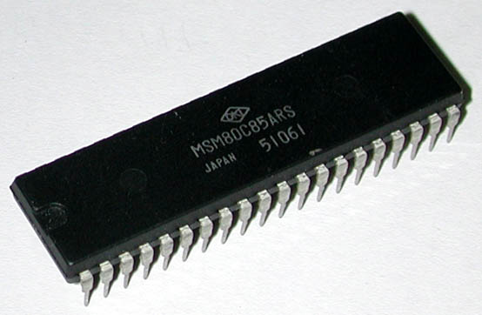
Intel 8085
Introduced in 1976.
It was also 8-bit µP.
Its clock speed was 3 MHz.
Its data bus is 8-bit and address bus is 16-bit.
It had 6,500 transistors.
Could execute 7,69,230 instructions per second.
It could access 64 KB of memory.
It had 246 instructions.

Slide 13
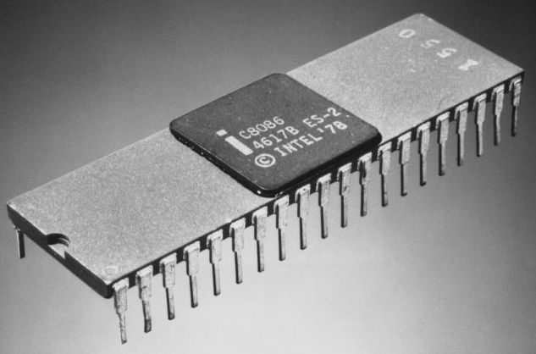
Intel 8086
Introduced in 1978.
It was first 16-bit µP.
Its clock speed is 4.77 MHz, 8 MHz and 10 MHz, depending on the version.
Its data bus is 16-bit and address bus is 20-bit.
It had 29,000 transistors.
Could execute 2.5 million instructions per second.
It could access 1 MB of memory.
It had 22,000 instructions.

Slide 14
